Slide 1

App by Perry and Jeff

Slide 2
What is our goal?
Social Network for getting people together to get things done
Centralized approach with a project manager
Decentralized approach
Skills-based recruiting

Slide 3

Cover page / Splash screen
We plan on adding:
Redirect to about page by clicking logo
“Sell the website” adding info about why you might use Brainstorm

Slide 4
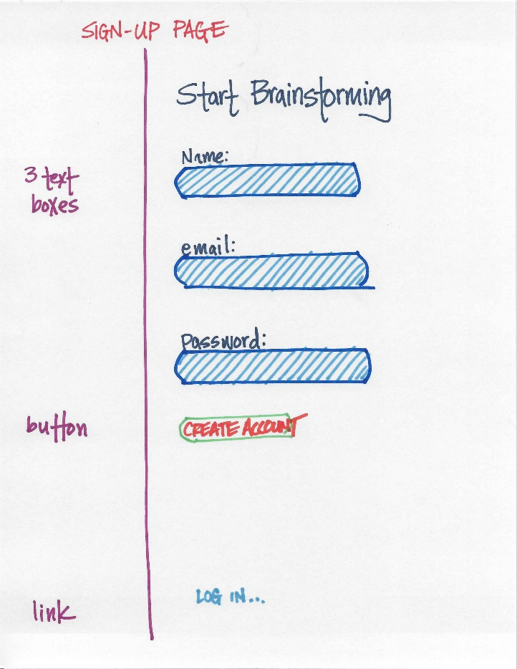

Slide 5
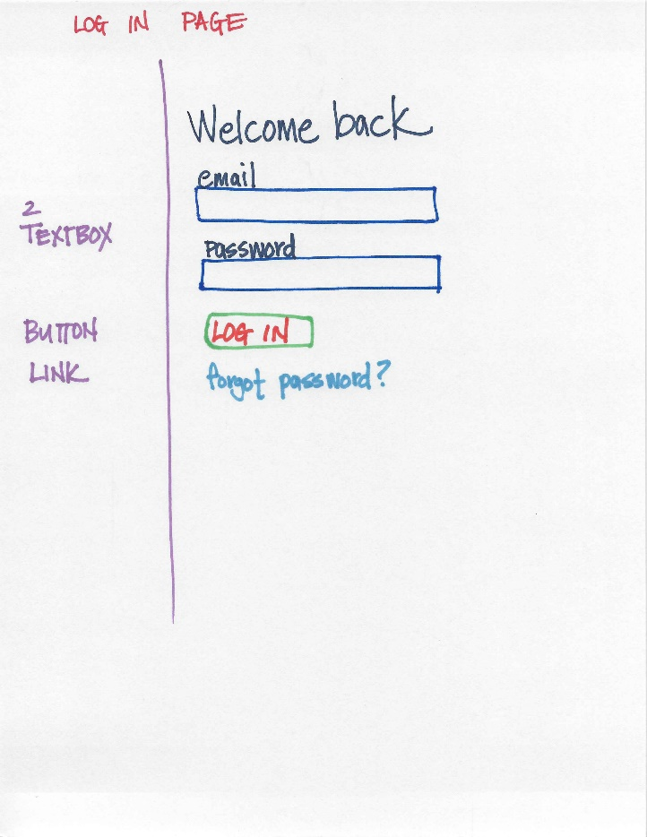

Slide 6
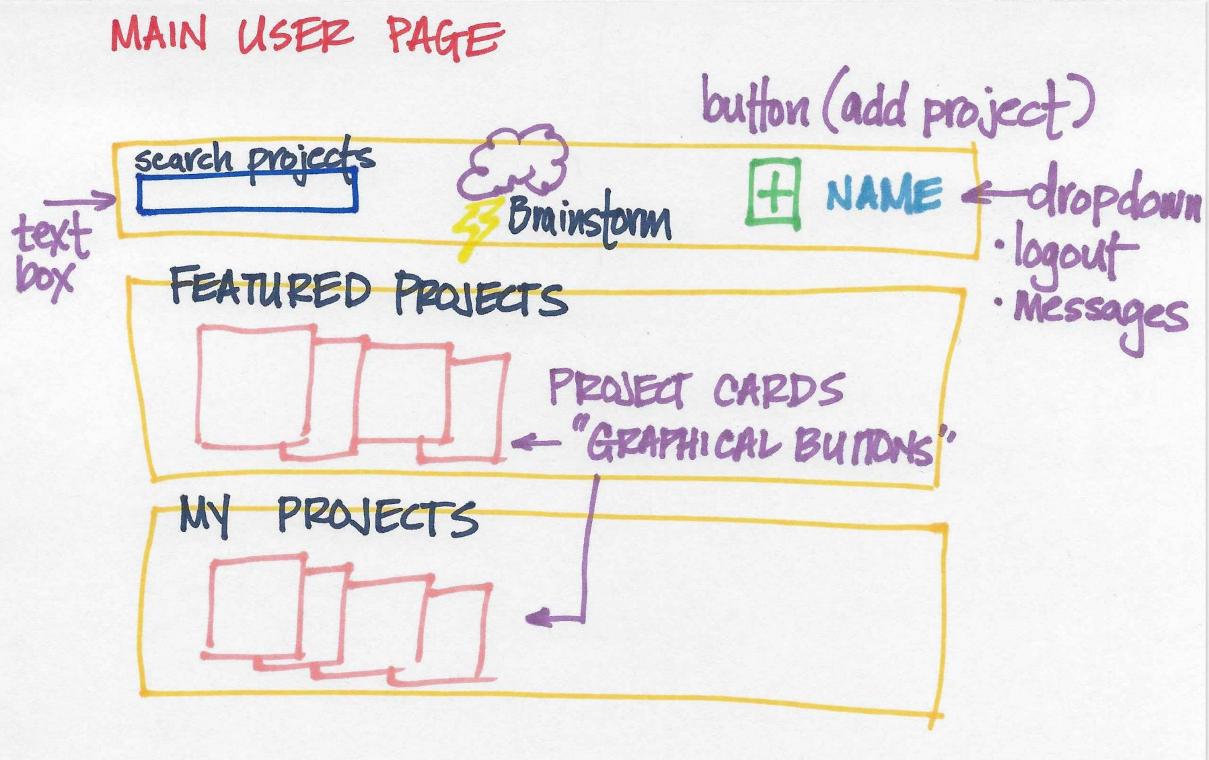
We will use CSS and JS to enhance and simplify
Project cards are thumbnails of project
Thumbnails will be small, mouse-over expand preview
AJAX for search suggestions
Dropdown menus to reduce clutter

Slide 7
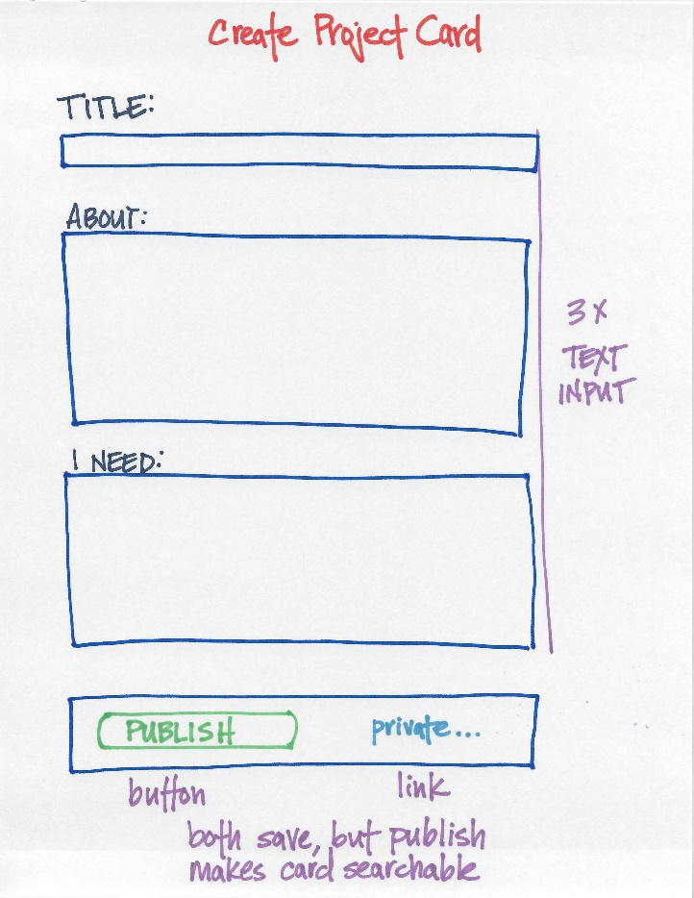

Slide 8
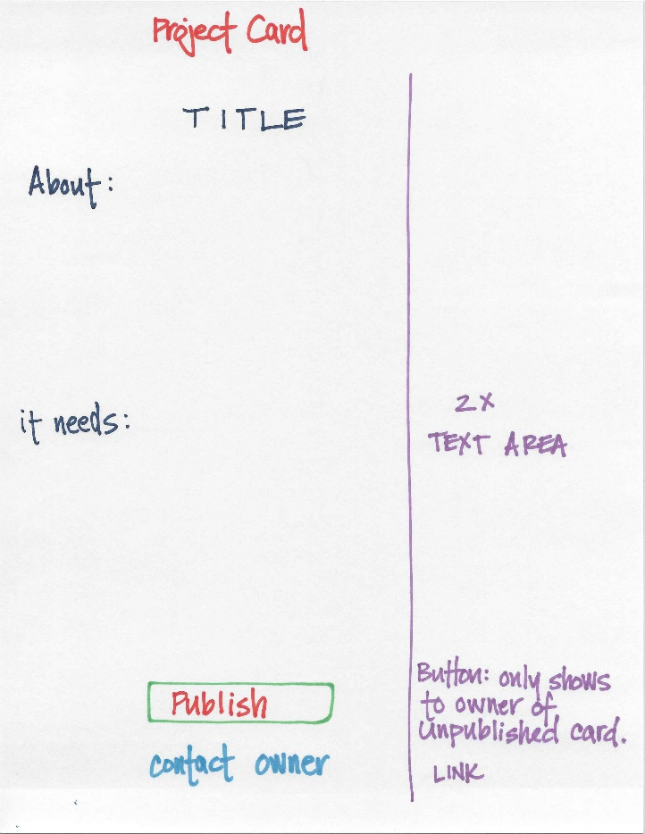
Might add personalization features
Selfie of project owner
Style themes based on project type? (maybe)
Lots of room per text area
Text areas also allow pictures

Slide 9
Backend
Storage on AWS
Use database
Holds template project cards based upon type of project
Holds username/password as parent file, child is multiple projects per user
Could monetize it by limiting project cards to 10 unless a premium sub is paid
If monetized, could use PayPal API
$$$$$$$$$$$$$$$$$$$$$$$$$$$$$$$
Could monetize by allowing ads
Could monetize by selling user information to advertisers
Could monetize by selling user information to NSA
Could monetize by selling website to Facebook

